Slide 1
Smart tiltmeter using image sensors Graduate: Denisa-Ionela PETRARU Coordinator: Septimiu-Sever POP

Slide 2

Measurement objectives
Increased precision
Immunity to environmental noise
Ease of use

Slide 3
How?

Slide 4
Measurement objectives
Increased precision
Filtering methods
Immunity to environmental noise
Sensor choice
Ease of use
Graphical user interface

Slide 5

Proposed measurement method

Slide 6
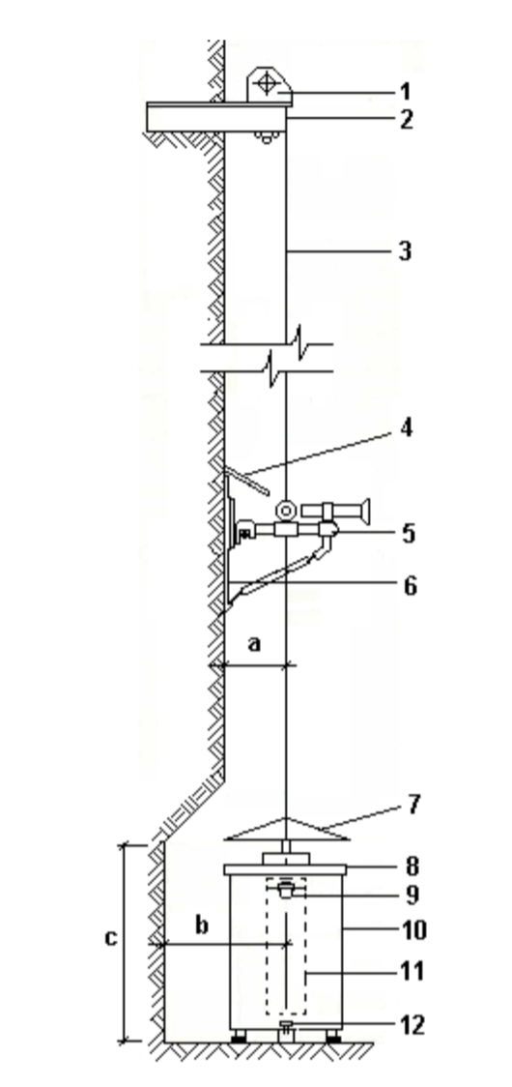
Pendulum tiltmeter

Slide 7
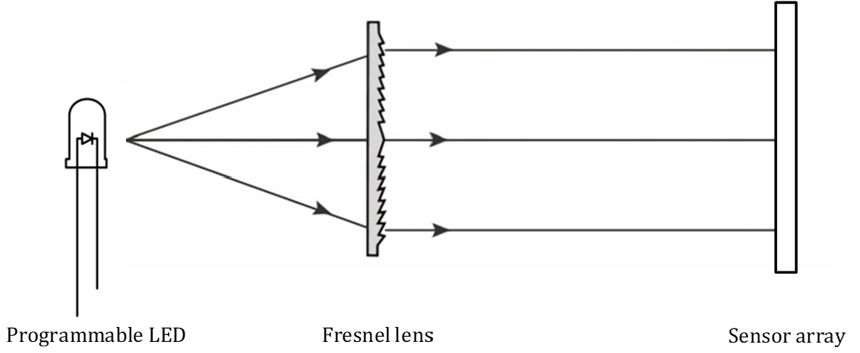
Optical method

Slide 8
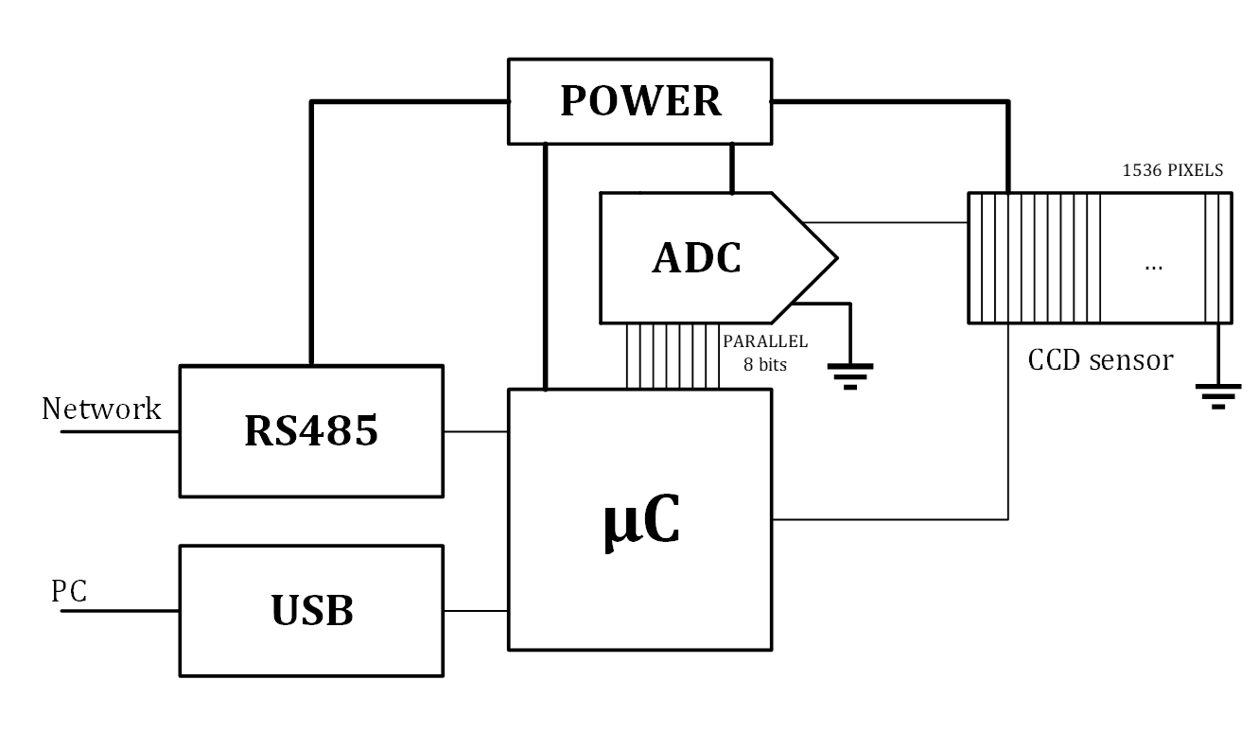
Embedded system

Slide 9
Implementation steps
Circuit design
- μC
- ADC
- USB
PCB design
- μC
- Sensors
- ADC
- USB
μC programming
- Signal generation
- Timer
- Comparator
- USART
Data handling
- Acquisition
- Filtering
- Displaying

Slide 10

Circuit design

Slide 11
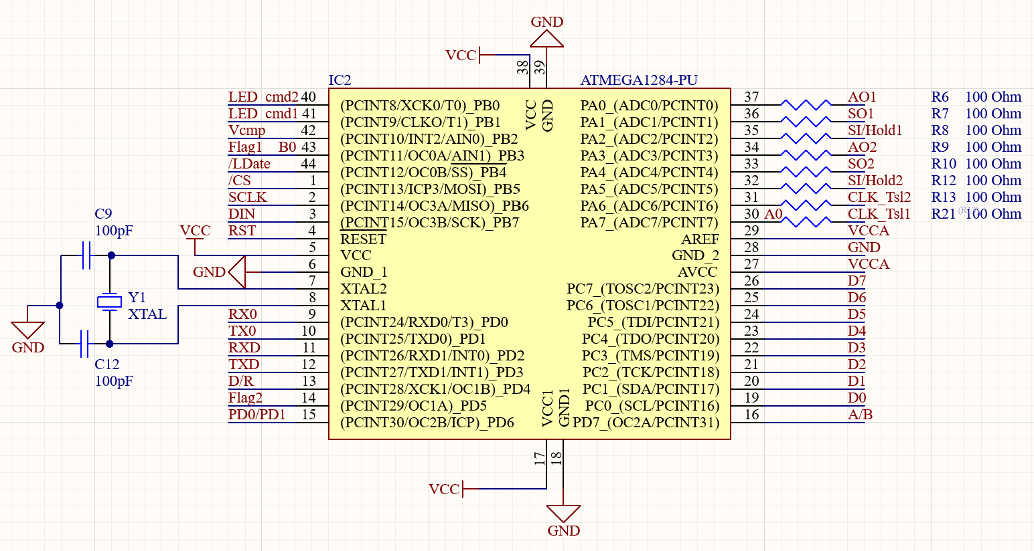
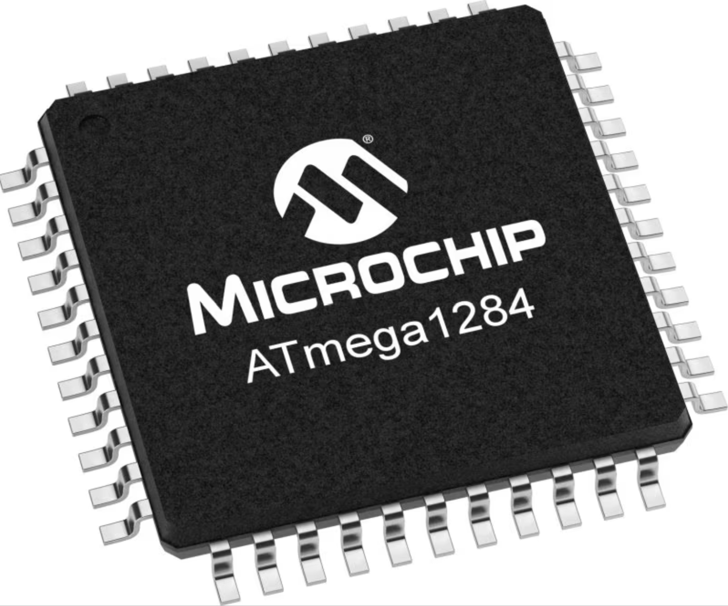
Microcontroller schematic – ATmega1284
Microcontroller programming
Reception/Transmission
Sensor pins
ADC pins

Slide 12
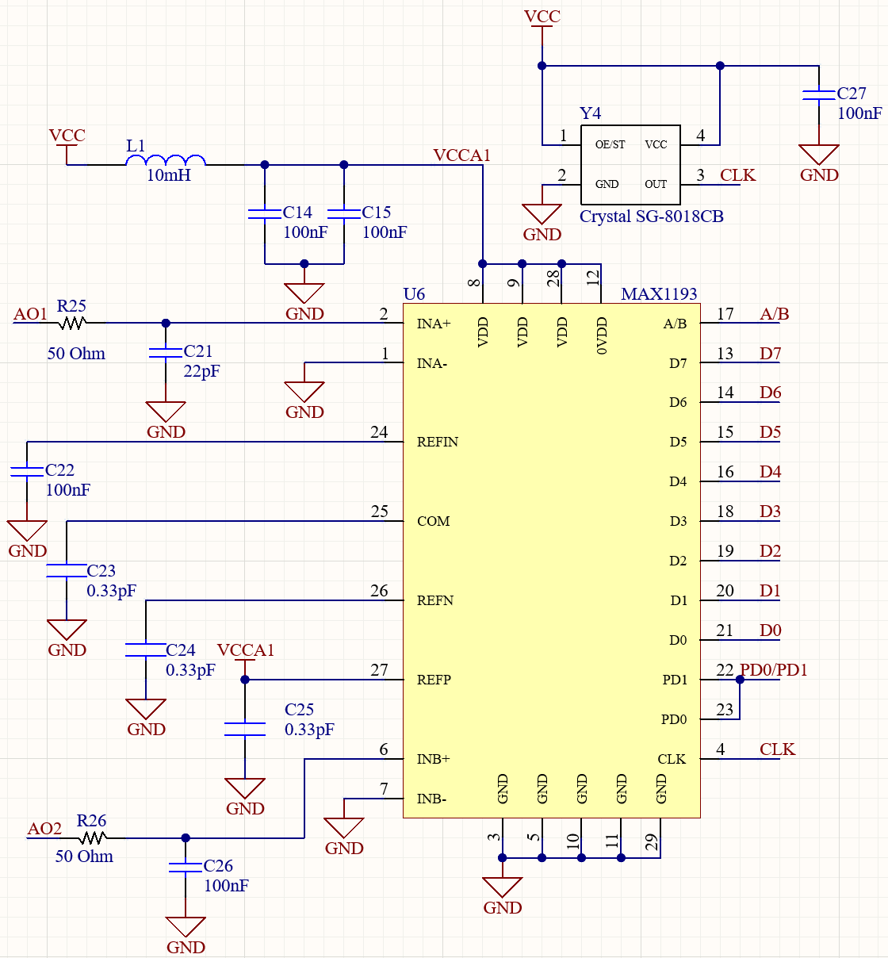
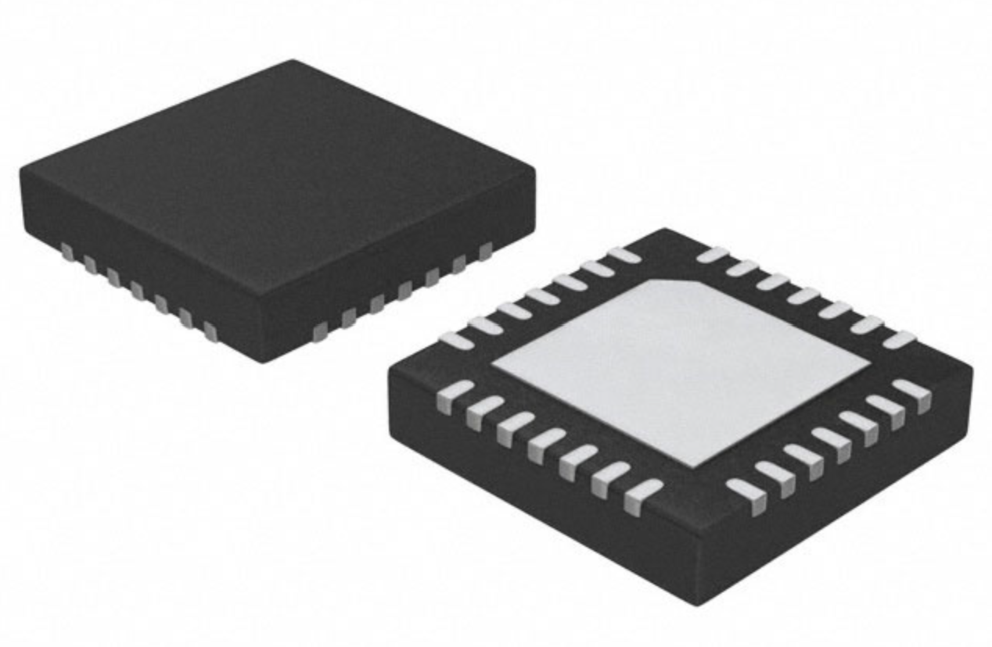
ADC block – MAX1193
Single ended input connections
Unbuffered external reference
External clock
Output data bits
Output channel indicator

Slide 13
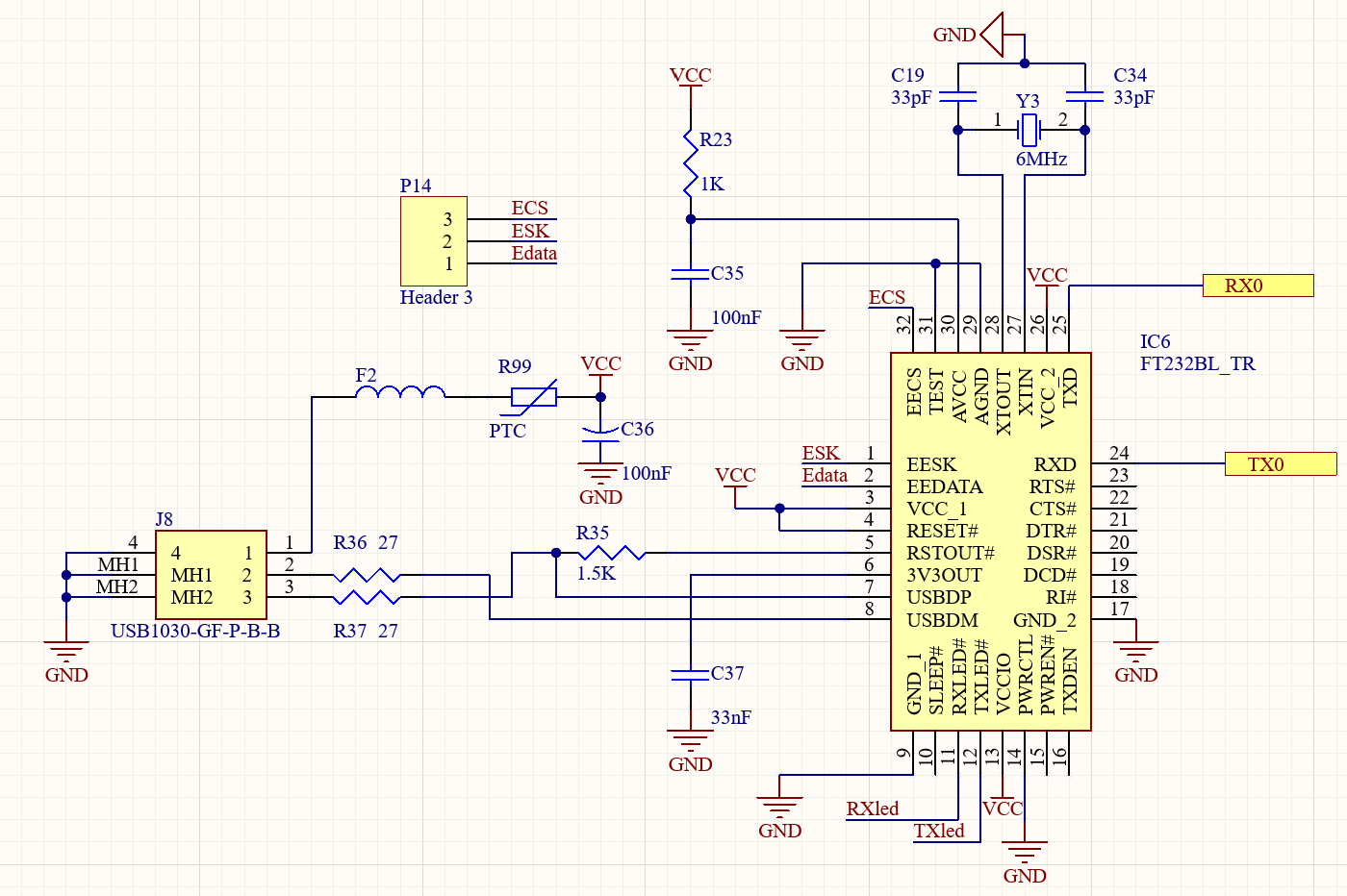
USB-USART conversion RS232BL
USB port
Protection elements
USBDP
&
USBDM
RX
&
TX

Slide 14

PCB design

Slide 15
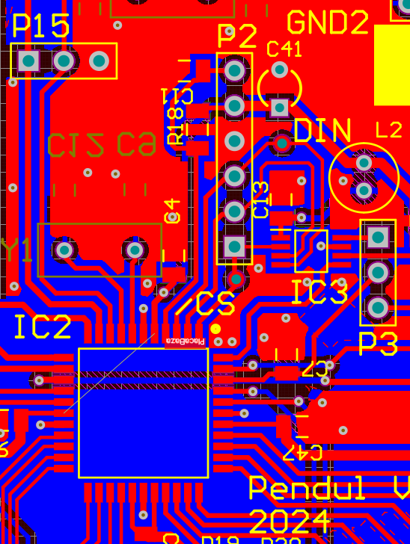
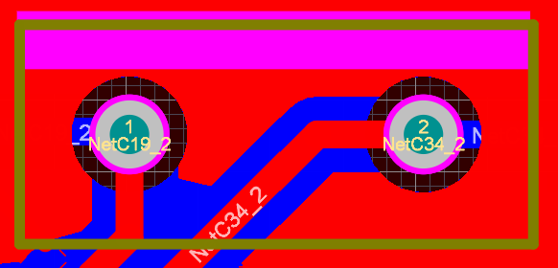

Microcontroller
Microcontroller programming pins
Oscillator details

Slide 16
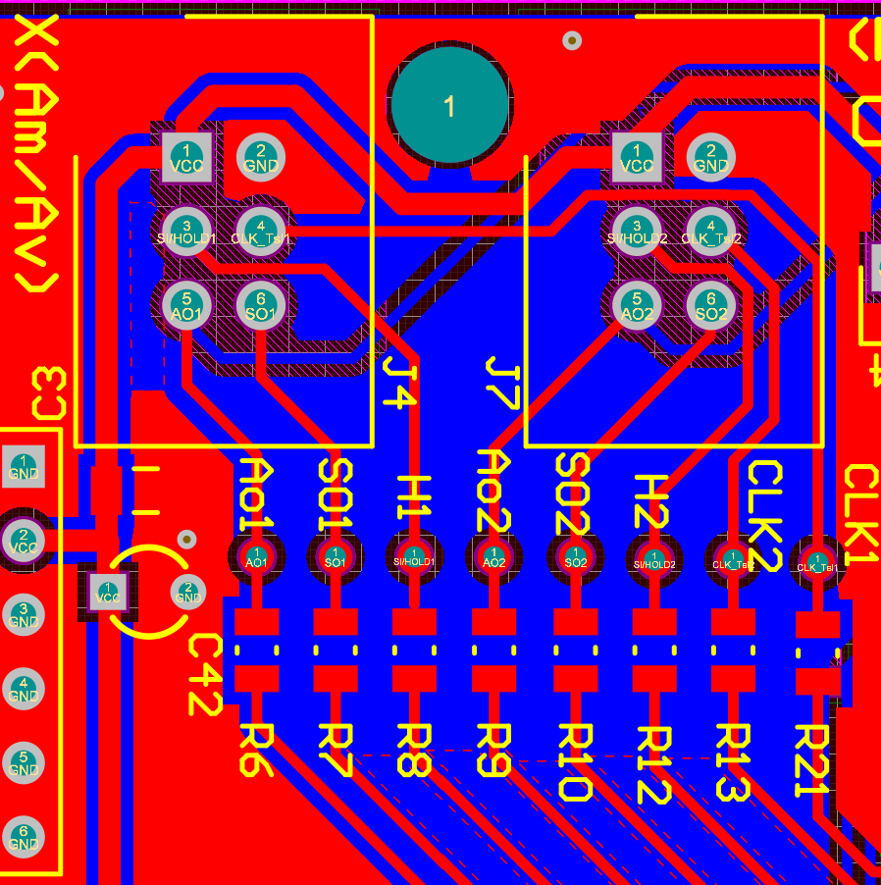
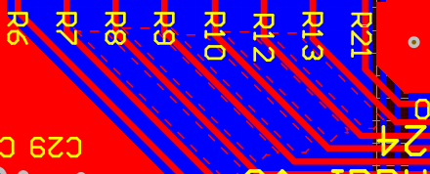
Sensor integration
Test point vias
100Ω resistances
Ground plane cutouts

Slide 17
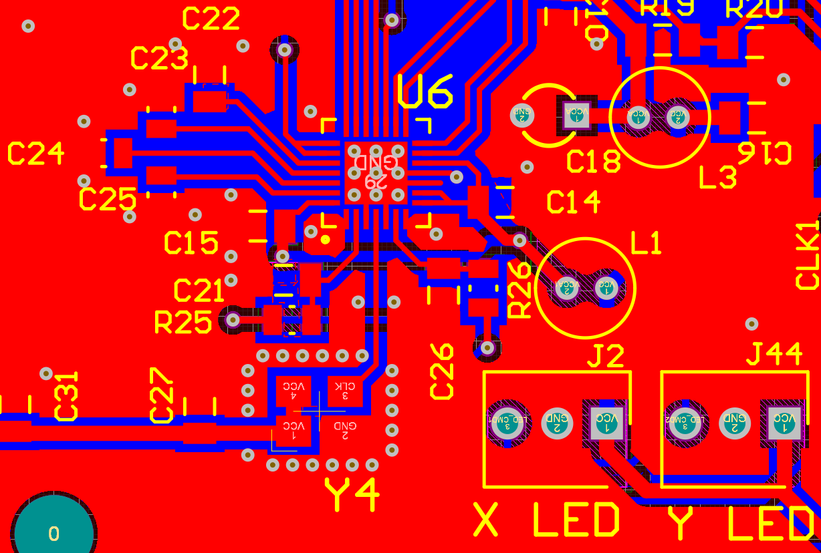
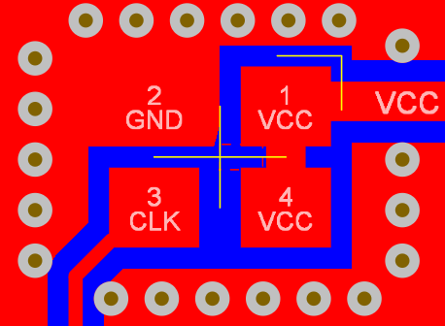
ADC
Oscillator guarding
Thermal vias

Slide 18
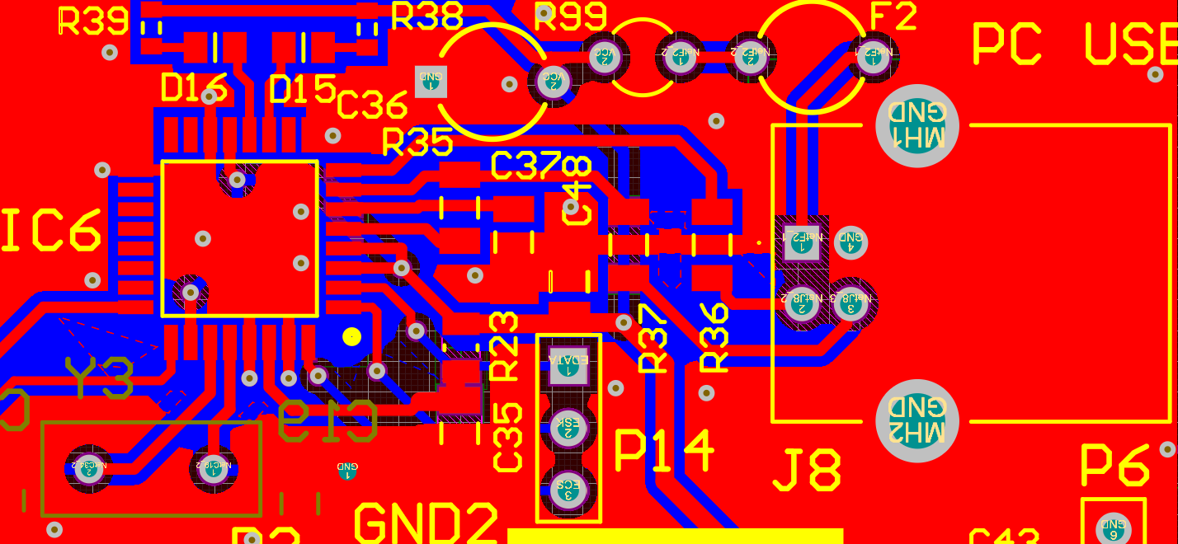
USB block
Ground vias
Indicator LEDs

Slide 19
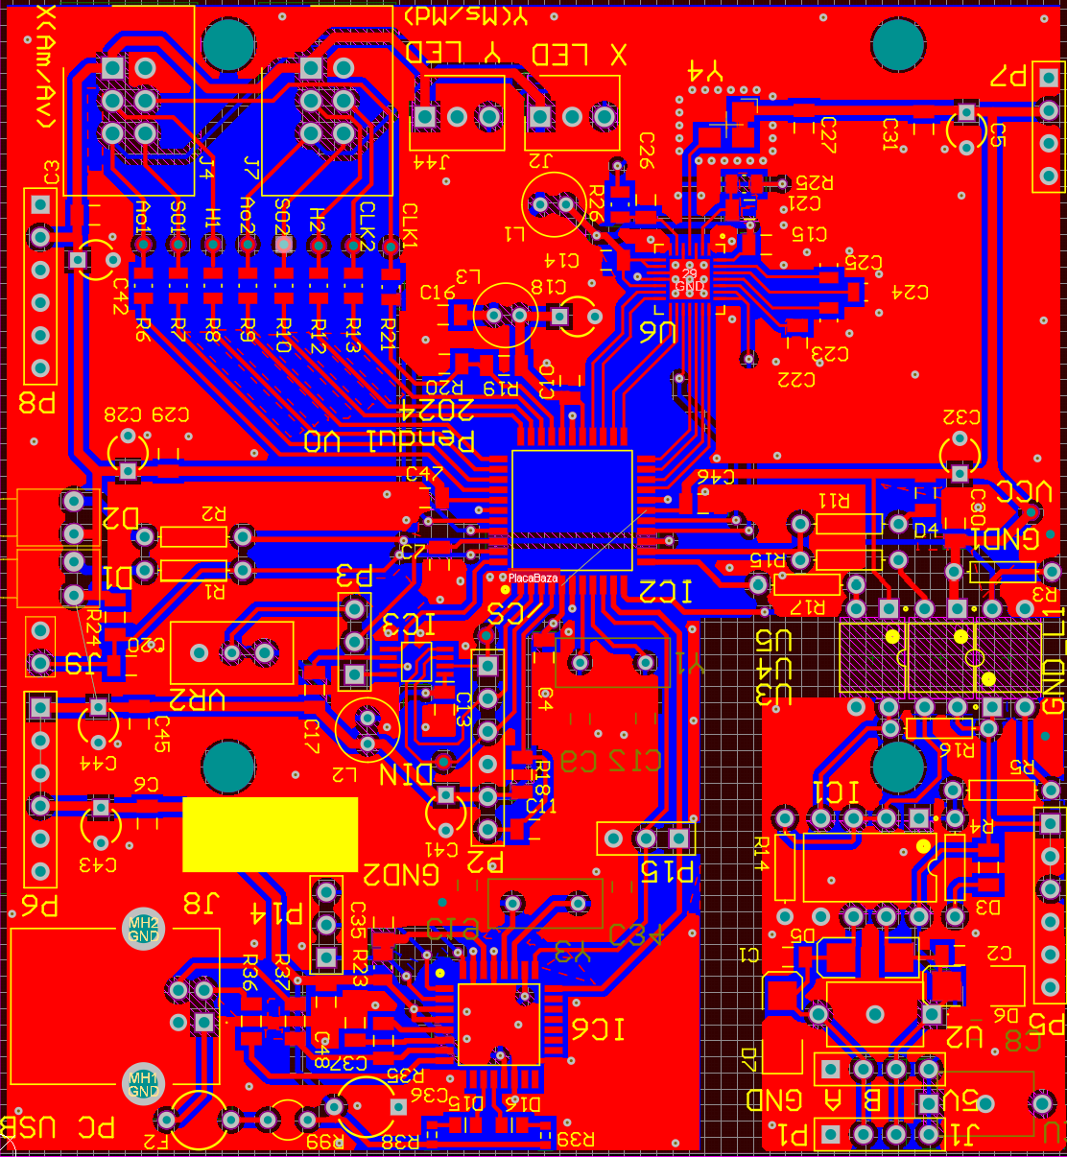
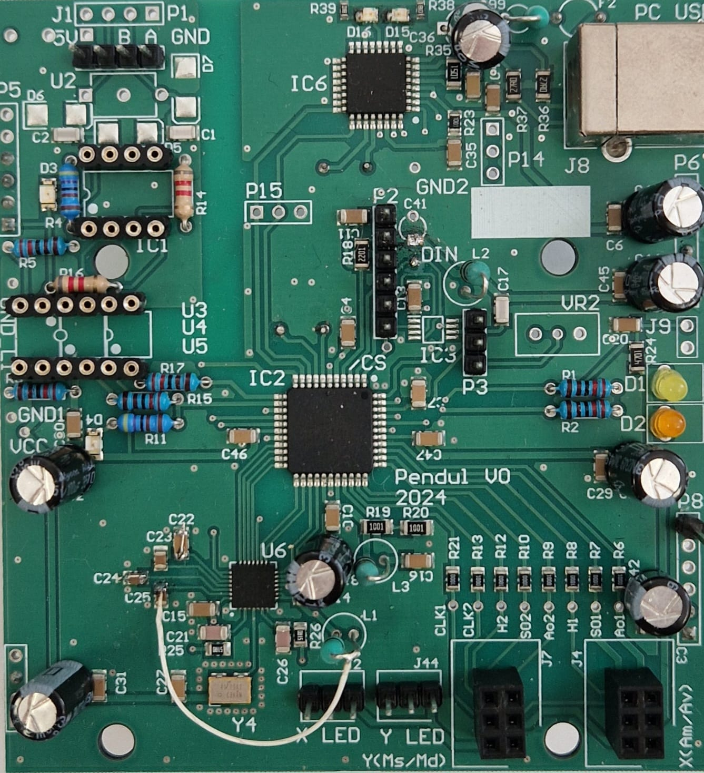
Final results

Slide 20
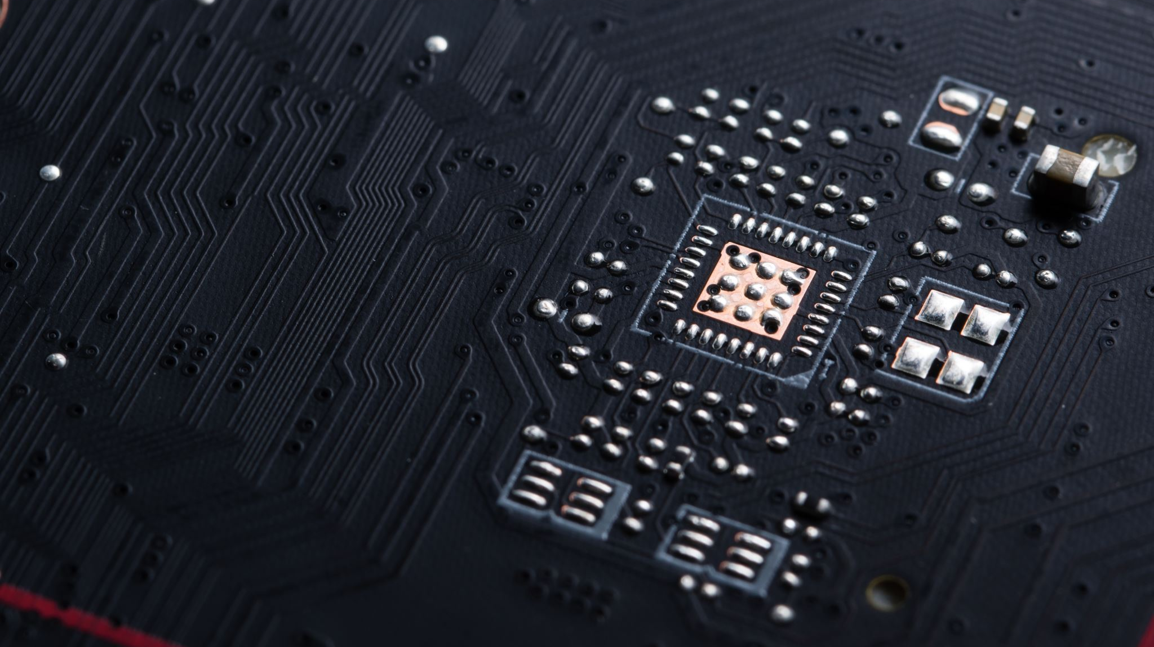
Microcontroller programming

Slide 21
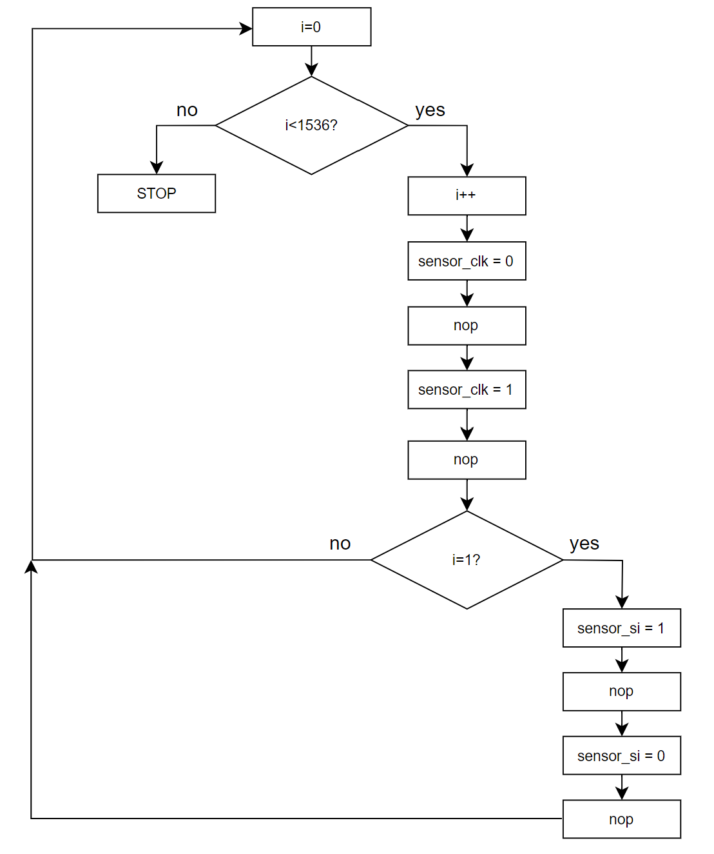
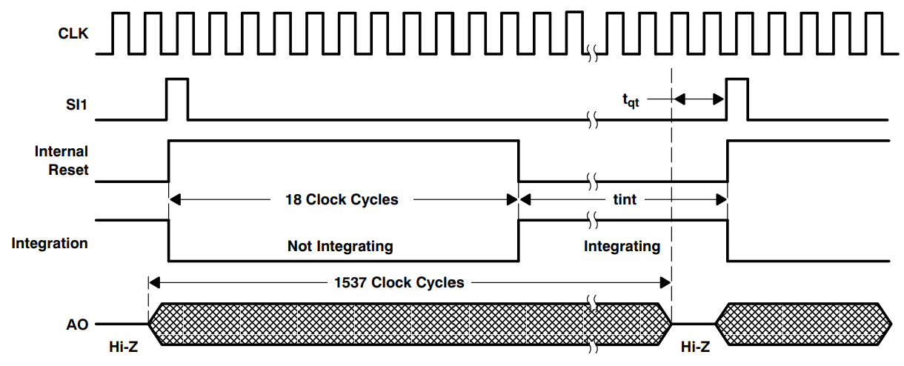
Signal generation
CLK and SI toggling
Levels generated by nop

Slide 22
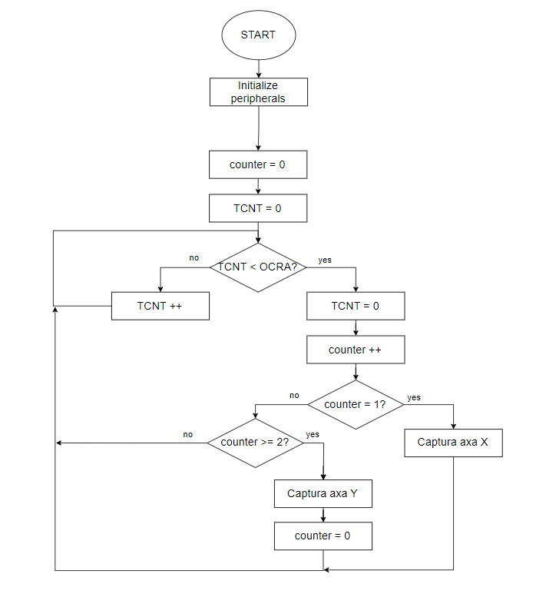
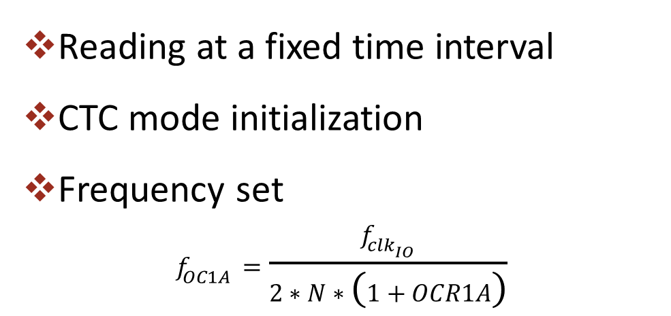
Timer
Reading at a fixed time interval
CTC mode initialization
Frequency set
$$f_{OC1A}=\frac{f_{clk_{IO}}}{2∗N∗\left(1+OCR1A\right)}$$

Slide 23
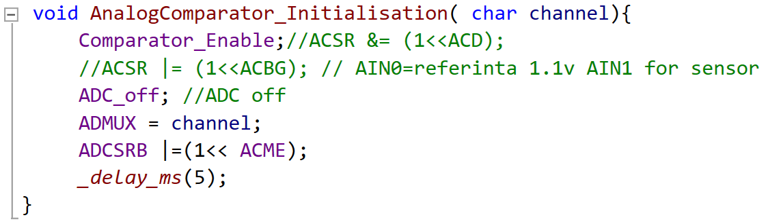
Comparator
Internal ADC – OFF
Positive input: bandgap internal voltage 1V1
Negative input: ADC multiplexer

Slide 24
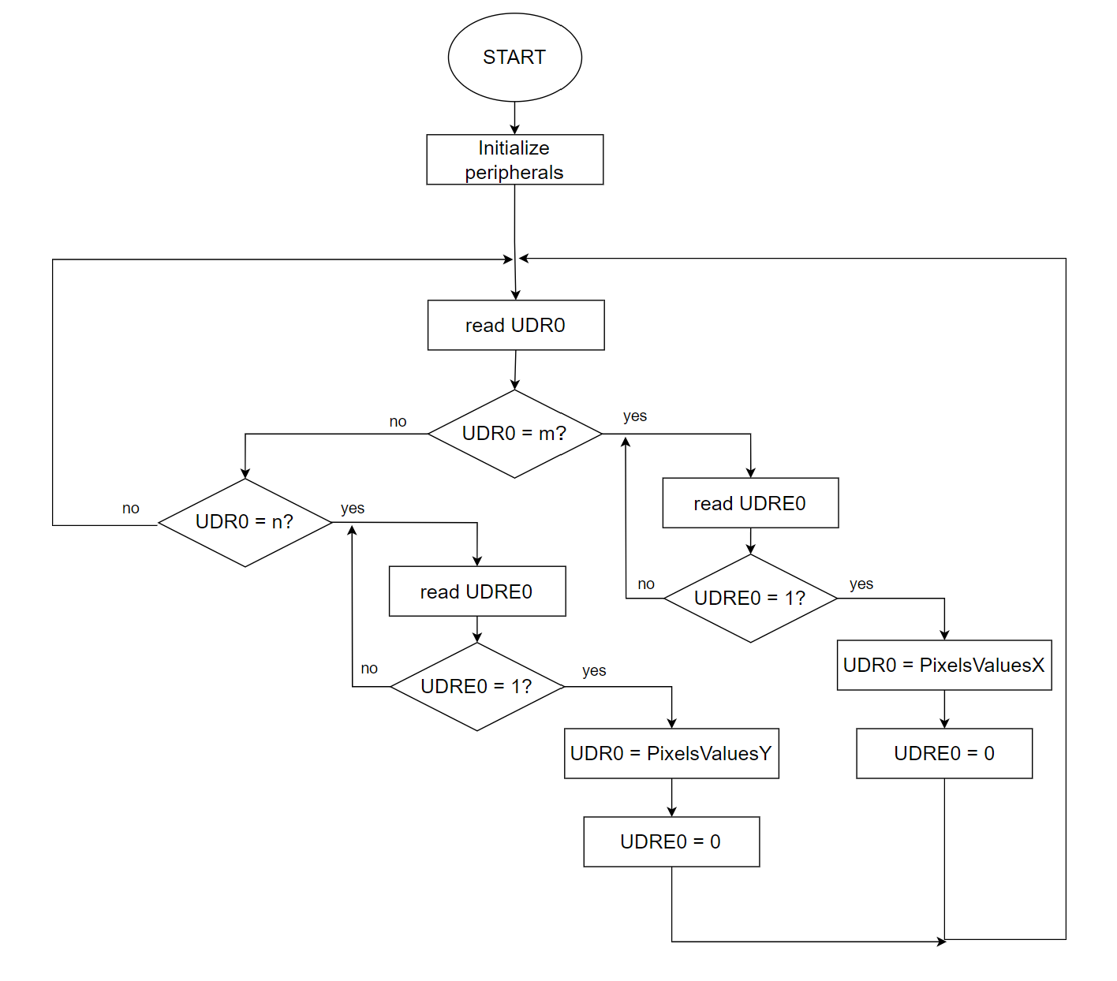
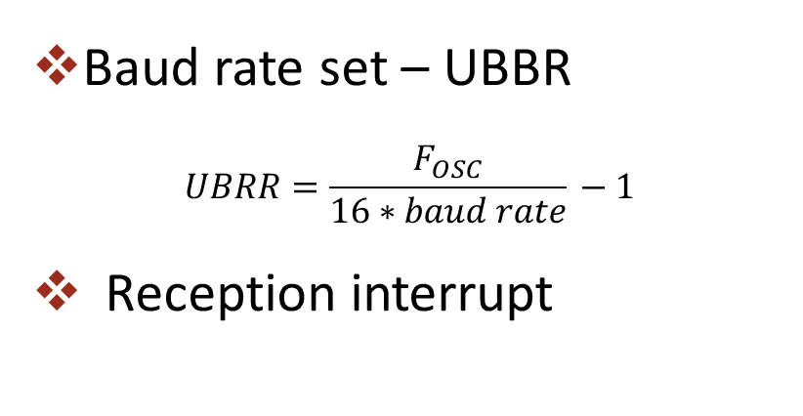
USART communication
Baud rate set – UBBR
$$UBRR=\frac{F_{OSC}}{16∗baud rate}−1$$
Reception interrupt

Slide 25

Data processing

Slide 26
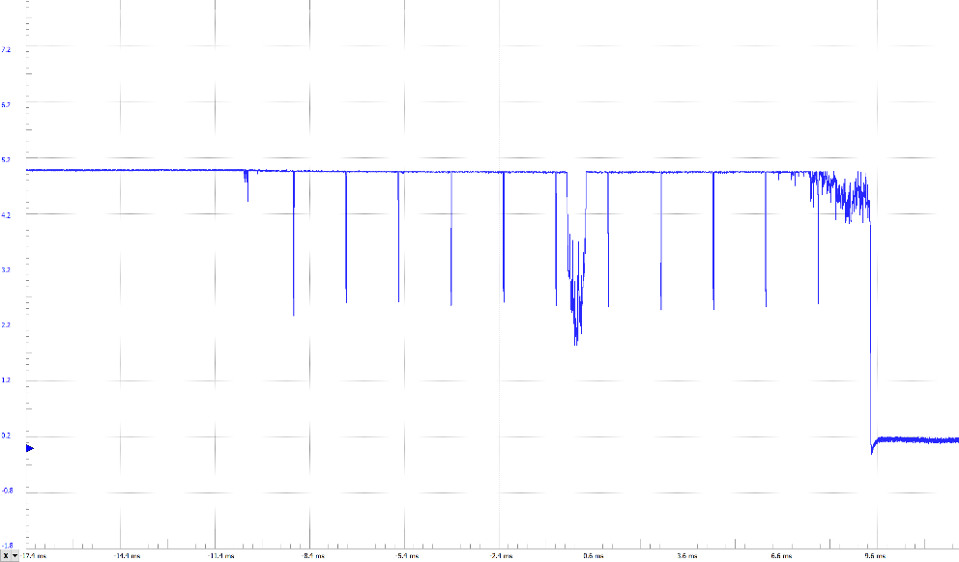
Signal acquisition
Edge effect noise

Slide 27
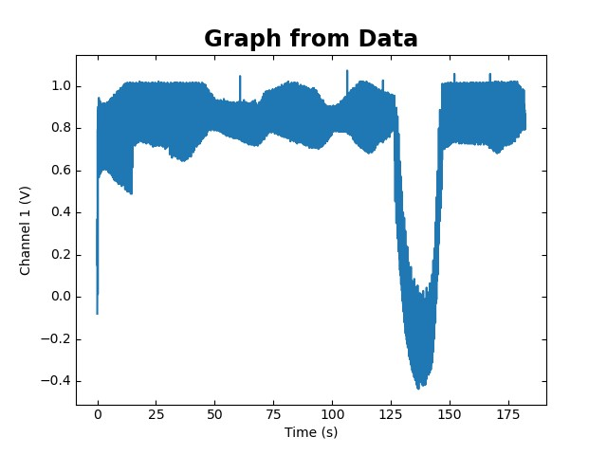
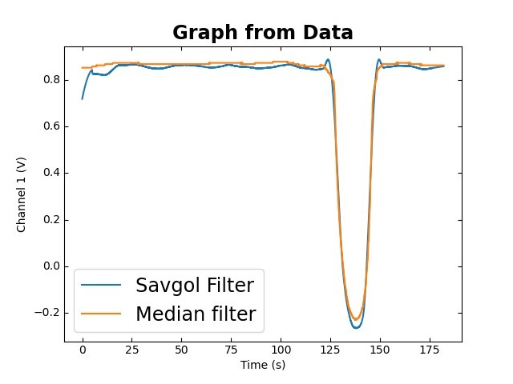
Filtering
Original signal
Filtered signals

Slide 28
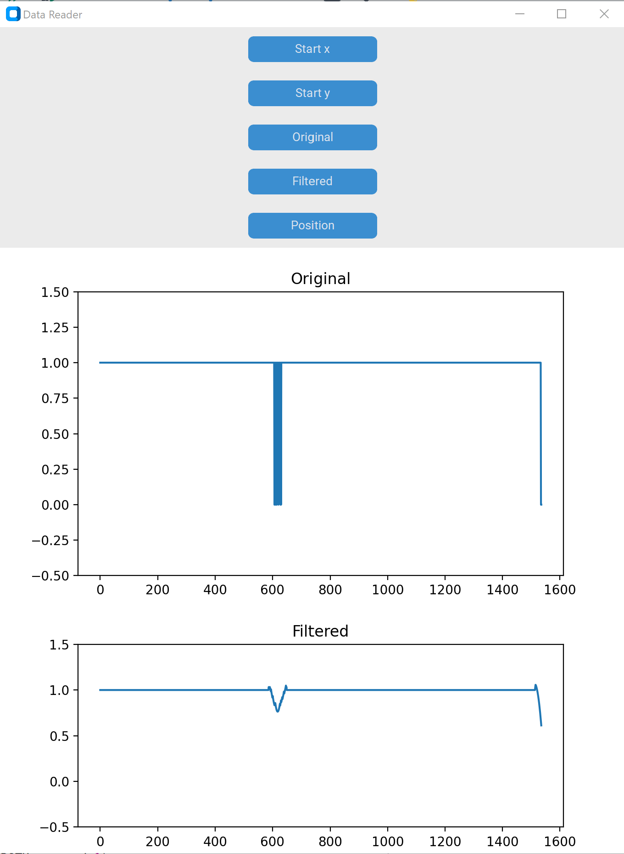
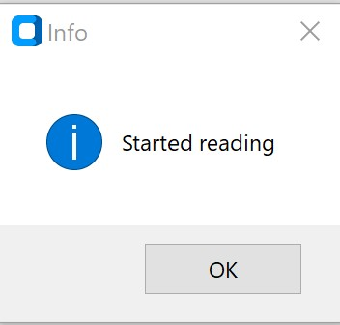
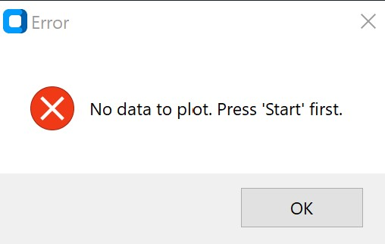
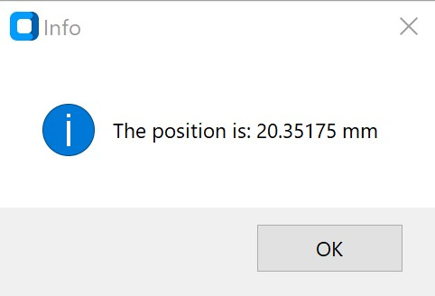
Graphical user interface
Iteration number | 1 | 2 | 3 | 4 | 5 | 6 | 7 | 8
Position value [mm] | 20.3517 | 20.3517 | 20.3517 | 20.2882 | 20.3517 | 20.3517 | 20.3517 | 20.4152

Slide 29
Conclusions
Fully functional model
Wide palette of technologies
The beginning of a greater purpose

Slide 30
Future improvements
Better communication between the ADC and μC
Live updates and measurements
Alerts
Wireless connection

Slide 31

Thank you for your attention!

